Slide 1
PMI Mumbai Chapter
In Retrospect
Leadership Institute Meeting
October 8 -10, 2009

Slide 2
The Beginning!
September 25, 1998 – First Members Meeting
1998/99 – Formation Application for
“Western India Potential Chapter”
May 2001- Chapter Accredited as
‘PMI Mumbai Chapter’
During the Period launched several activities:
Monthly Open Forum
Quarterly Newsletter
PMPCE Training Courses and Written Exams
Quarterly Seminars etc.

Slide 3
Main principle: Give strong support to PMI in their defined purpose of dedication to advancing the state of art in project management
VISION
  To be recognized as the organization of choice by evangelizing Project Management.
MISSION
  Evangelize project Management across industry, academia, community and government.
  Provide a forum for project management professionals to promote the principles and ethical standards of PMI.

Slide 4
OBJECTIVES
  Image & Brand Building
  Networking and Community
  Professional Development
  Knowledge
  Advocacy aligned with PMI

Slide 5
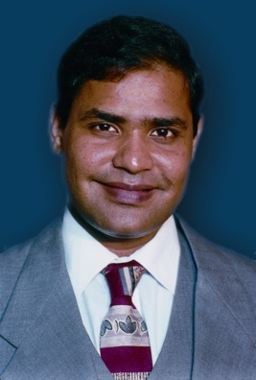

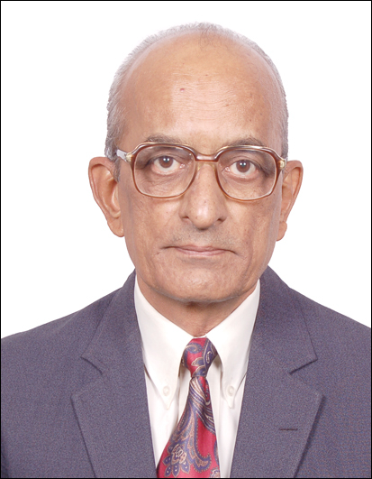



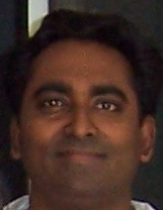



THE TEAM
Ramesh V. Joshi
Founder President, V. P - Communications
Sharad Harale
V.P. – Certification Training
Rakesh Gupta
V.P. – Branches
Tejas Sura
President
Chandrashekhar Joshi
V.P. - Finance
Zubin Kika
V.P. – Programs
Hari Thapliyal V.P. – Volunteer
Madhav Prabhu V.P. – Corp. Rel.
Zubin Kika
V.P. – Programs
Ravi Eppaturi
V.P. – Corporate Relations
Yagna Boorada
V. P. – PMP Club
Kumar Vaalsalam
VP-Publication
D Y Pathak Advisor
Bharat Bhagat
Advisor
R C Goyal
VP-PMPClub

Slide 6
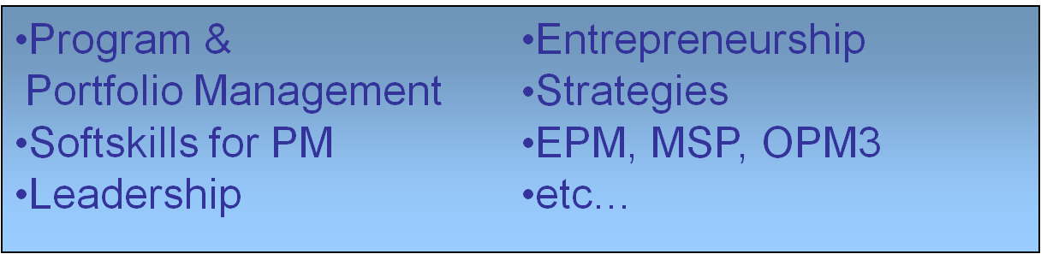
Monthly Networking PMP Club Meetings
  Over 100+ events
  60 -120 attendees
  Covering Hot Topics in Project Management
  Being conducted Monthly in five different locations

Slide 7
Education
  PMP Certification Examination Preparatory Courses
  75+ courses conducted
  1500+ Project Managers trained
  Faculty with Total Experience of 100+ years
  Corporate Training for Companies such as IBM, Accenture, Wipro , L & T Infotech, Coconut Software
  Provided updating for four PMBOK revisions
  Main revenue earner

Slide 8
Education (contd.)
  Library
    100 + Titles on Project Management
    Continuous up gradation with new titles
  Training to Corporate employees

Slide 9
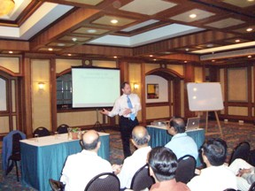
Conferences & Workshops (Programs)
  Conference on Quality in PM
  Project Management, CQPM 2007
  International Project Management Day, IPM 2008
  Various Seminars on interesting topics from Leadership to Project Management for Aerospace, DPC/EPC, IT Companies, etc.
  Soft Skills

Slide 10
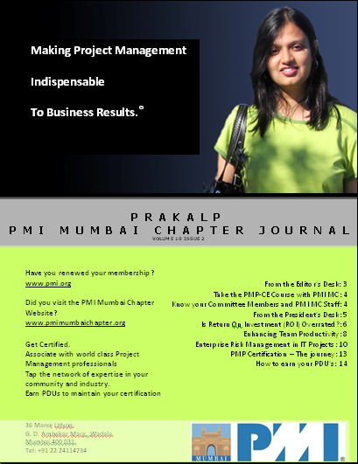
Publication
  Quarterly
  ‘Prakalp’ Journal
  Papers by Local PMs
  Update on Events

Slide 11
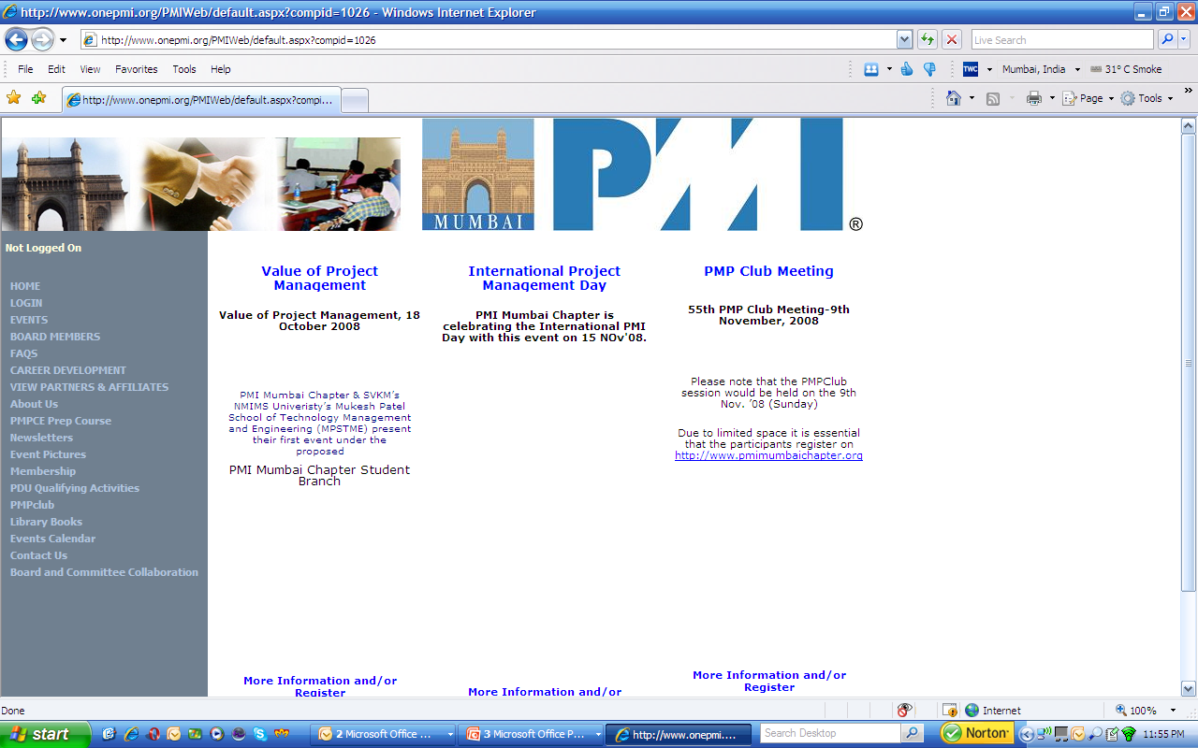
Website: http://www.pmimumbaichapter.org

Slide 12
Branches
  Ahmedabad activities since Nov. 2007
  Student Branch at MPSTME and other institutes
  Talks on for Branches at Nagpur, Jamnagar
  Looking at Potential Locations such as Navi Mumbai
  Launched two branches including one Students Branch
  Regular Monthly Meetings & PMPCE PC being conducted
  Looking for Leaders to form LIGs

Slide 13
PMIMC New Office
  About 1,000 Sq. Ft. own New Office cum Training premises at Goregaon
  Expected to be functional by early next year
NGOs:
  Social Sector: Completed one Training Program for NGO
  Other opportunities being explored
  individuals
Plenty of Volunteer opportunities to satisfy dedicated individuals
As per Sri Ravi Shankar :
………..service is the passport to leadership.

Slide 14
Communications: Initiated broad basing of the activity to cover:
  Mass Mailing through Constant Contact
  PPT Loops during Events
  Mailing of Monthly Chapter Updates (Newsletters)
  Welcoming New Members by Letters, Introducing New Members during Monthly PMP Club Meetings
  On-Line conferencing & Webinars
  Participation in OnePMI conferences: Website & SharePoint
  Job postings on PMIMC website; Registration for Consultants
  Events Feedback collection & compilation of LL
  Encouraging participation in PMP CLUB yahoo group & PMI Mumbai Chapter – LinkedIN

Slide 15
Association with Other Professional Bodies
  Other PMI Chapters of India
  International PMI Chapters such as Washington D.C., Tokyo
  Computer Society of India
  Bombay Management Association
  Institution of Engineers

Slide 16
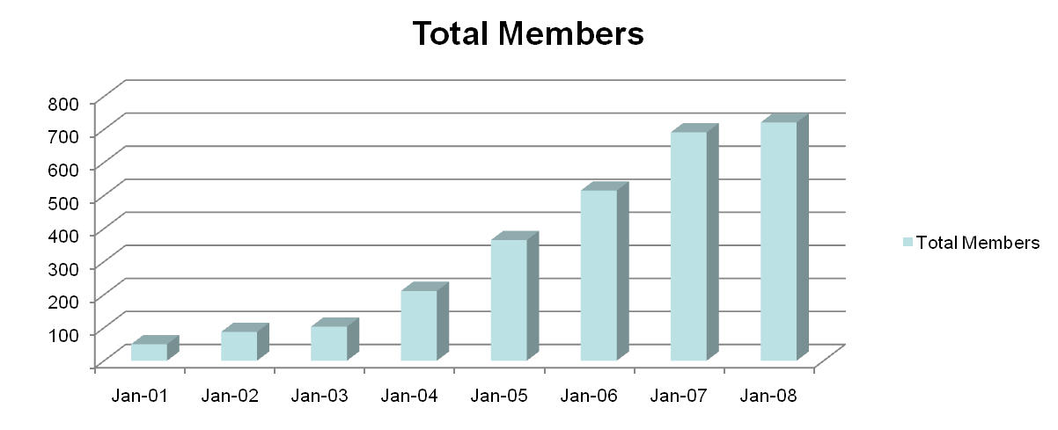
Membership & Growth
  Current count 725+ (Currently about 830)
  Highest Growth Rates amongst Regional Chapters

Slide 17
Futures Plans
  Expand Networking, Training Activities & Programs
  Participate in PMI “Community Leadership Online Community” and “Tech MAG” initiatives.
  Attain ISO 9001 certification for the Chapter
  Collaborate with Chapters worldwide

Slide 18
Futures Plans &Aspirations
  To increase Membership to 1000+ by 2009
  To hold a National Conference on Project Management
  To represent at more Global PMI Events – already represented at Seattle, Atlanta, Bangkok, Sydney
  To speakers to other Chapters
  To implement e-learning medium of training
  Comply with PMI SAS in totality
  Organize “Leadership Meeting” to Develop leaders

Slide 19
Futures Plans
  Expand Networking, Training Activities & Programs
  Participate in PMI “Community Leadership Online Community” and “Tech MAG” initiatives.
  Attain ISO 9001 certification for the Chapter
  Collaborate with Chapters worldwide

Slide 20
What, we believe, helped us to win the Award!
Filing an application for Award (which is challenging)!
Result oriented approach; shunning of politics (Leadership)
Firing on all Activity Cylinders (dedicated BOD)!
Increased interaction with Stakeholders thru:
- Mass Mailing to effectively reach the Membership
- Monthly Networking meetings at five locations/Branches
Sound financial position
Building on success!

Slide 21
Thank you !!
Tejas V. Sura, Chapter President
president@pmimumbaichapter.org

